Slide 1
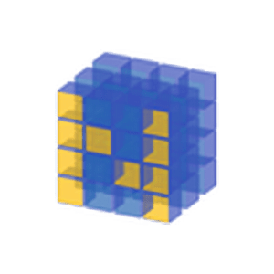
Python Workshop
Fundamentals and Numpy

Slide 2
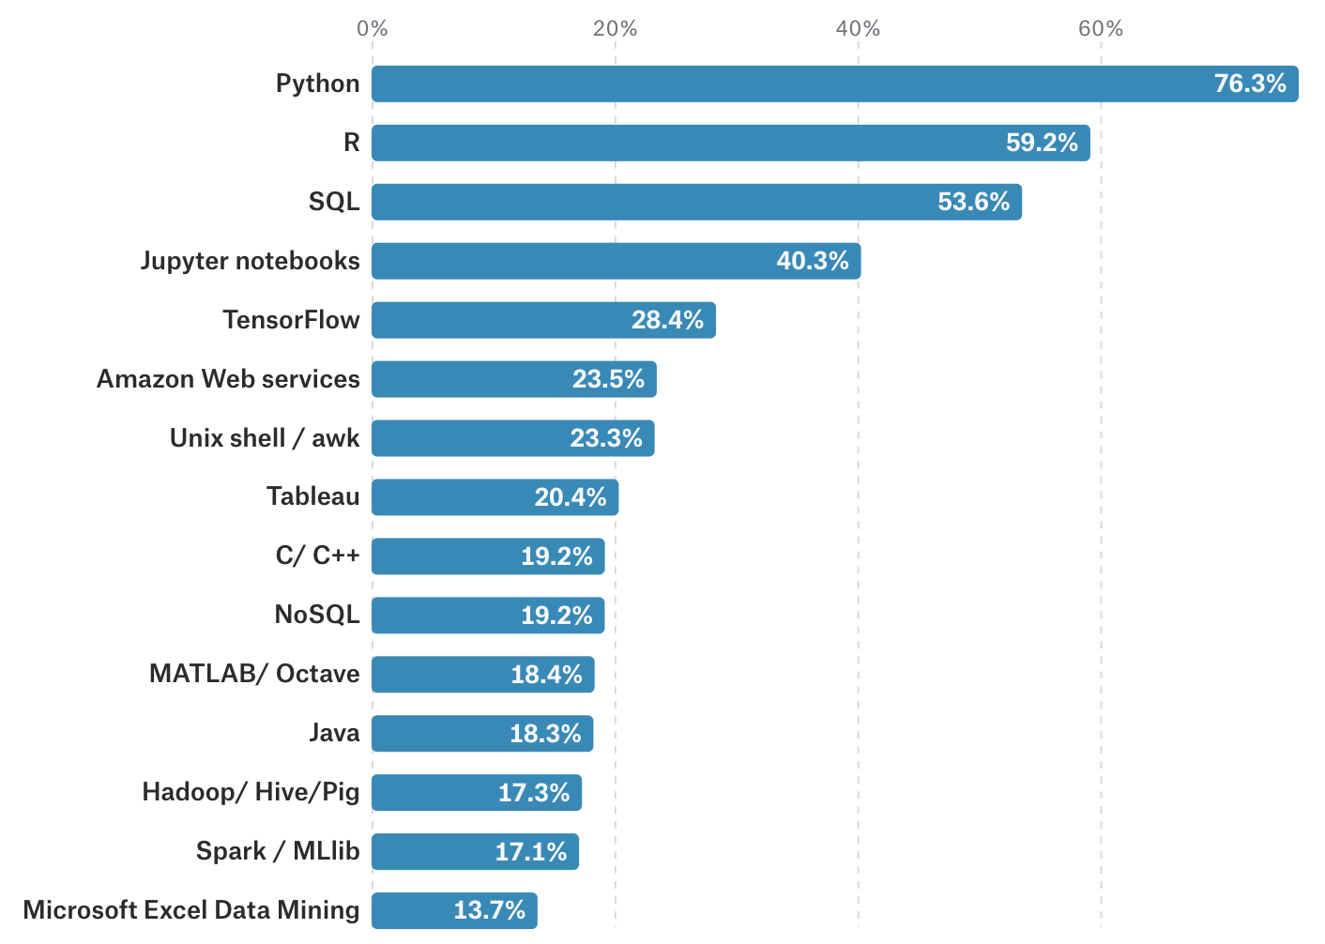
From November 2018

Slide 4
https://www.spyder-ide.org/
https://repl.it/repls/FavoriteMonstrousMainframe

Slide 5
Quick Fundamentals

Slide 6
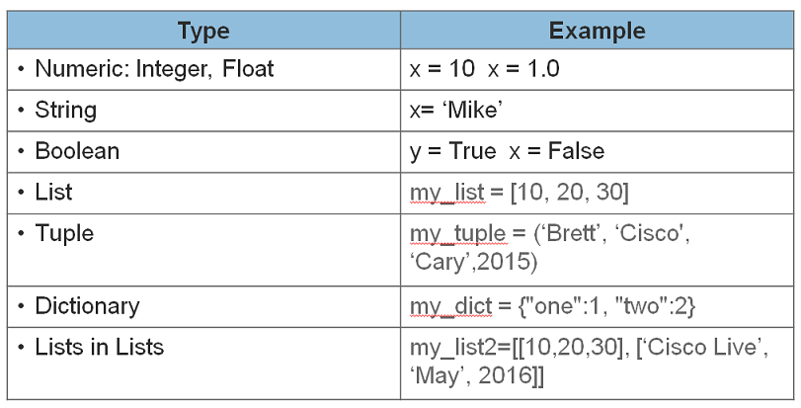

Slide 7
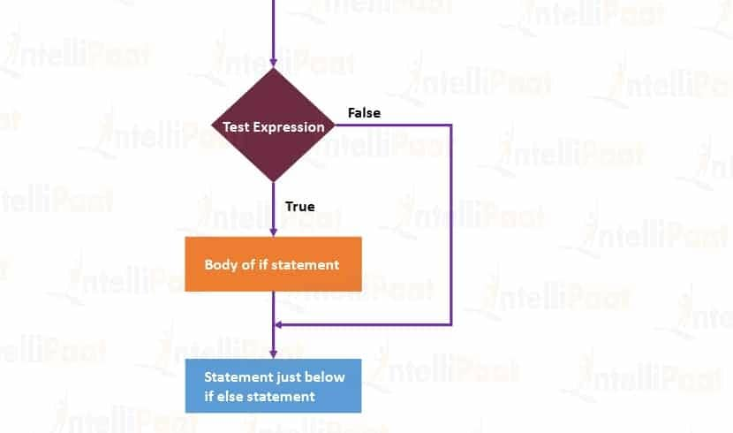

Slide 8
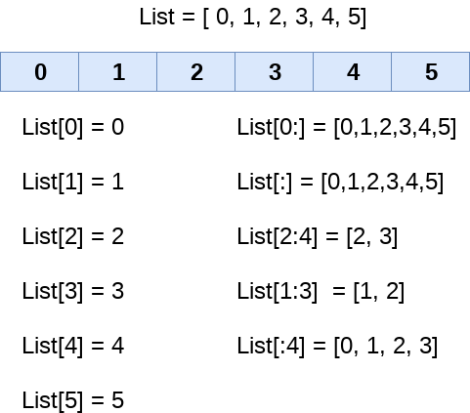
Data Structures - List

Slide 9
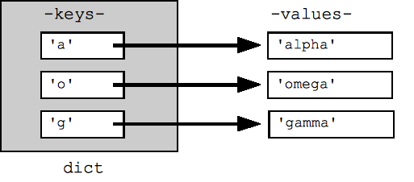
Data Structures - Dictionaries

Slide 10
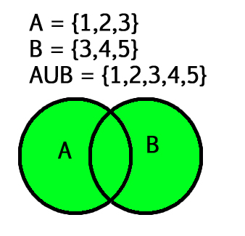
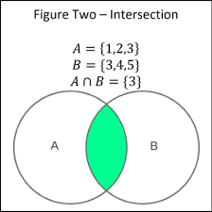
Data Structures - Set

Slide 11
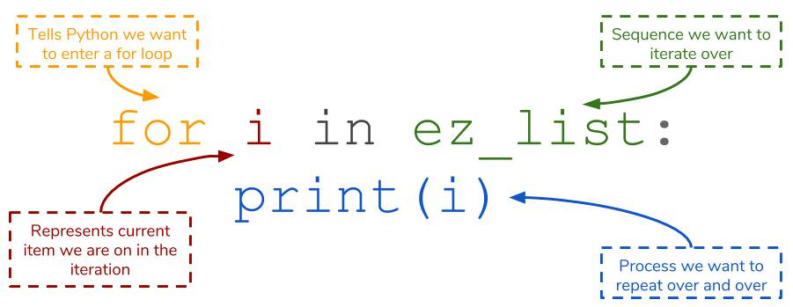
For Loops

Slide 12
Functions

Slide 13
Quick Numpy

Slide 14
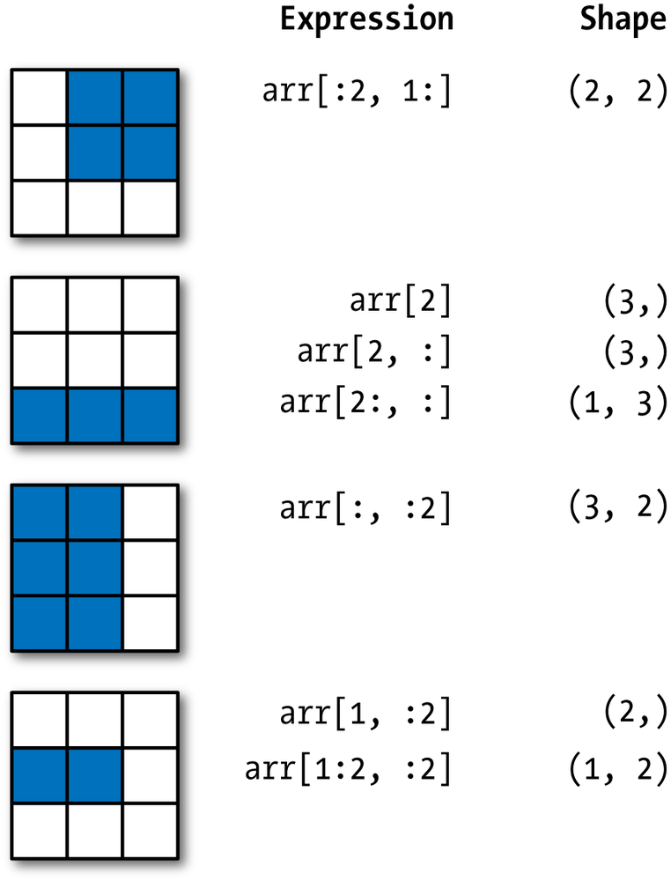

Slide 15
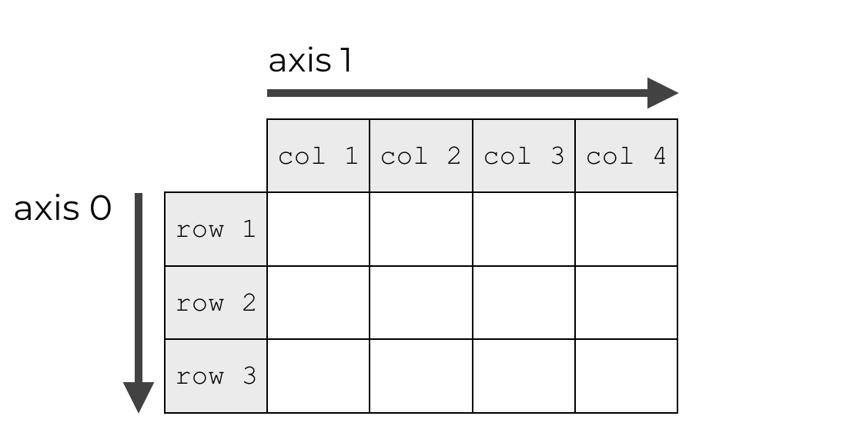
Axes

Slide 16
Quiz Questions
Create a function that takes in a list as an input; return a list where each element increases by 5.
Create a 5 x 5 matrix full of zeros. Make the value of the second row, second column equal 5.
Create a matrix that ranges from (1, 15) and make sure that the size is a 3 x 5 matrix.

Slide 17
Coming up…(Stay tuned in two weeks!)

Slide 18
Resources (Absolutely Use these!!!)
http://people.duke.edu/~ccc14/sta-663-2017/index.html <- Duke University
https://github.com/rougier/numpy-100/blob/master/100_Numpy_exercises.ipynb <- Numpy Exercises
http://cs231n.github.io/python-numpy-tutorial/#numpy < - Stanford
Master File: https://docs.google.com/document/d/1eVFHahTmTAz7rRFxEVc6F7oY58KndecZJ9mQa-qoqmw/edit#heading=h.9pn5asgwyhkt

Slide 19
Thank you!!!

