Slide 1
Python Workshop
Numpy and Pandas

Slide 2
Last Time
Data Types
Data Structures
Lists
Dictionaries
Sets
For loops

Slide 3
Packages
A module is a single file (or files) that are imported under one import and used
A package is a collection of modules in directories that give a package hierarchy.

Slide 4
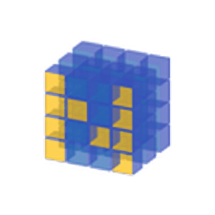
Quick Numpy

Slide 5
Quick facts:
Numpy is the foundation for numerical computation
The most basic structure in numpy is the ndarray. It is similar to a list. These allow us to build vectors and matrices.
Because you can build vectors and matrices, it’ll be helpful for you to know the dimensions of your arrays.
Some differences between ndarrays:
Take up less space in memory
Faster with computations (Duh...)
Better for linear algebra operations
Rank, dot/inner procuts, eigenvalues

Slide 6
Numpy Array Creation
np.arange
np.zeros
np.eye
np.diag
np.linspace

Slide 7
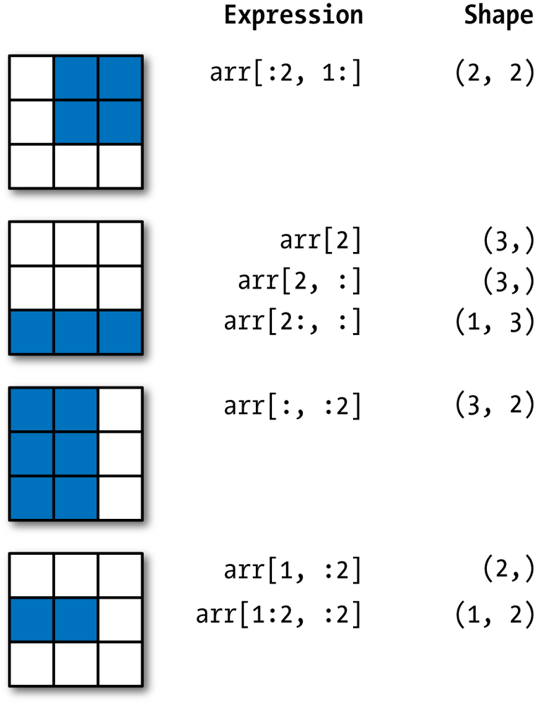
Indexing

Slide 8
Numpy Quick Math
Mean
Sum
Standard Deviation
Min
Max
Argmin
Argmax

Slide 9
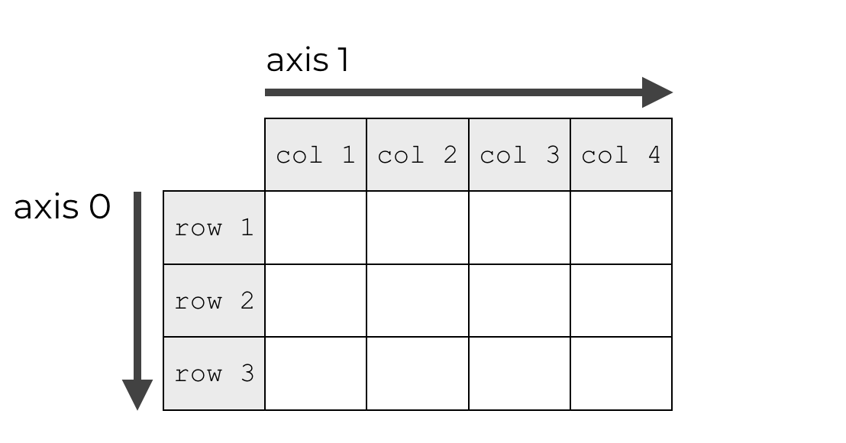
Axis

Slide 10
Quick Pandas

Slide 11
Series
Similar to lists. One dimensional array.
Big difference: it has associated array of labels - indices. You are able to create the labels for each of the entries. Similar to dictionary.

Slide 12
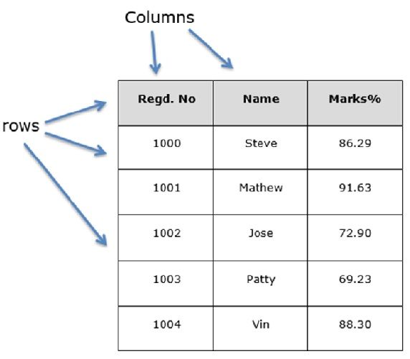
Dataframe

Slide 13
Dataframe Indexing

Slide 14
Coming Up..

